Slide 1
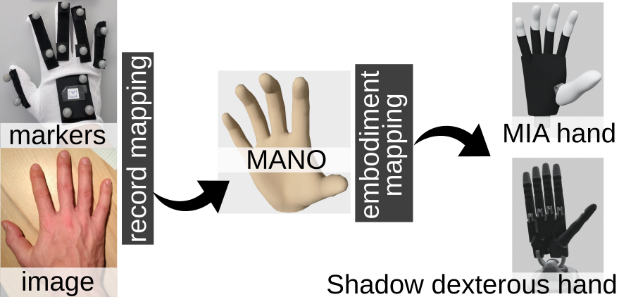
A Modular Approach to the Embodiment of Hand Motions from Human Demonstrations
2022 IEEE-RAS International Conference on Humanoid Robots
Alexander Fabisch, DFKI GmbH
alexander.fabisch@dfki.de
Manuela Uliano, Scuola Superiore Sant’Anna
Dennis Marschner, University of Bremen
Melvin Laux, University of Bremen
Johannes Brust, DFKI GmbH
Marco Controzzi, Scuola Superiore Sant’Anna
Source code: https://github.com/dfki-ric/hand_embodiment

Slide 2
Objectives
A modular framework to transfer human hand motions to robotic hands
adaptable to new input modalities by replacing the record mapping
result of the record mapping is a common representation of hand states (MANO model)
adaptable to new target systems through configuration
fast enough to enable immediate transfer in teleoperation

Slide 3
Idea

Slide 4
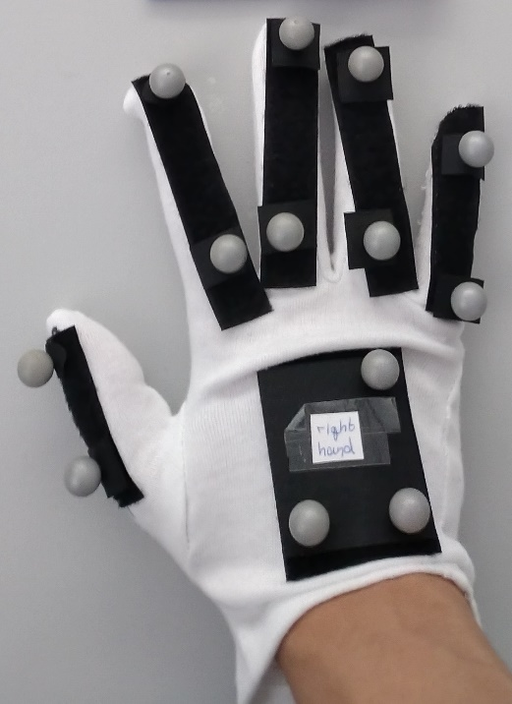
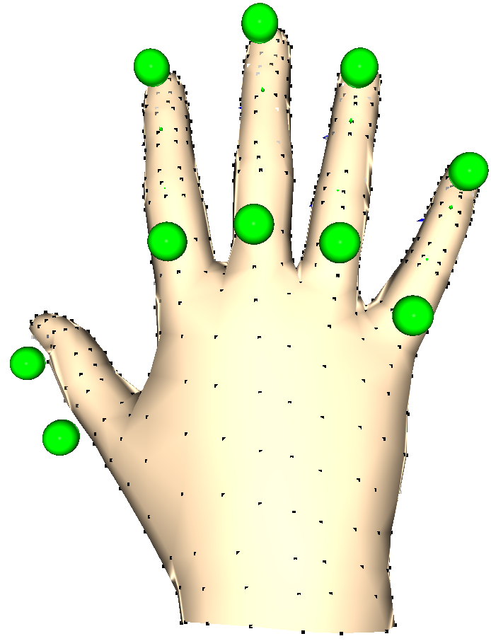
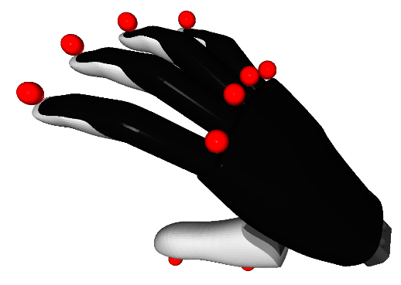
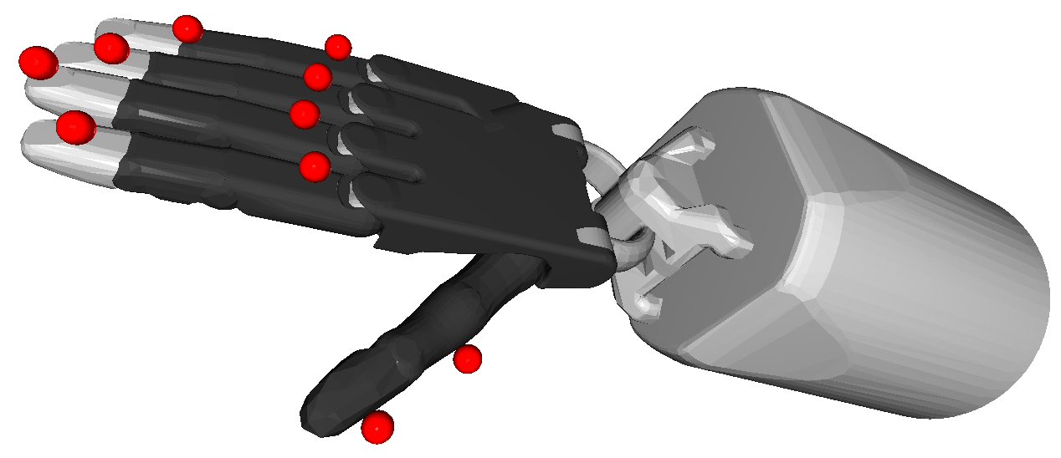
Mapping – Implementation
Objective: minimize error between virtual marker positions
Expected / virtual markers
Virtual markers
Objective: minimize error between markers and expected marker positions

Slide 5
Dataset

Slide 6
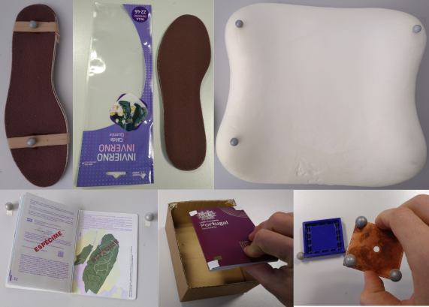
Motion Capture Dataset
Task | Object | Samples
Grasp | Insole | 213
Insert | Insole, bag | 12
Grasp | Small pillow | 224
Grasp | Big pillow | 130
Insert | Passport, box | 37
Flip pages | Passport | 38
Grasp | Electronic components | 55
Insert | Electronic components | 54
 | Total | 763

Slide 7
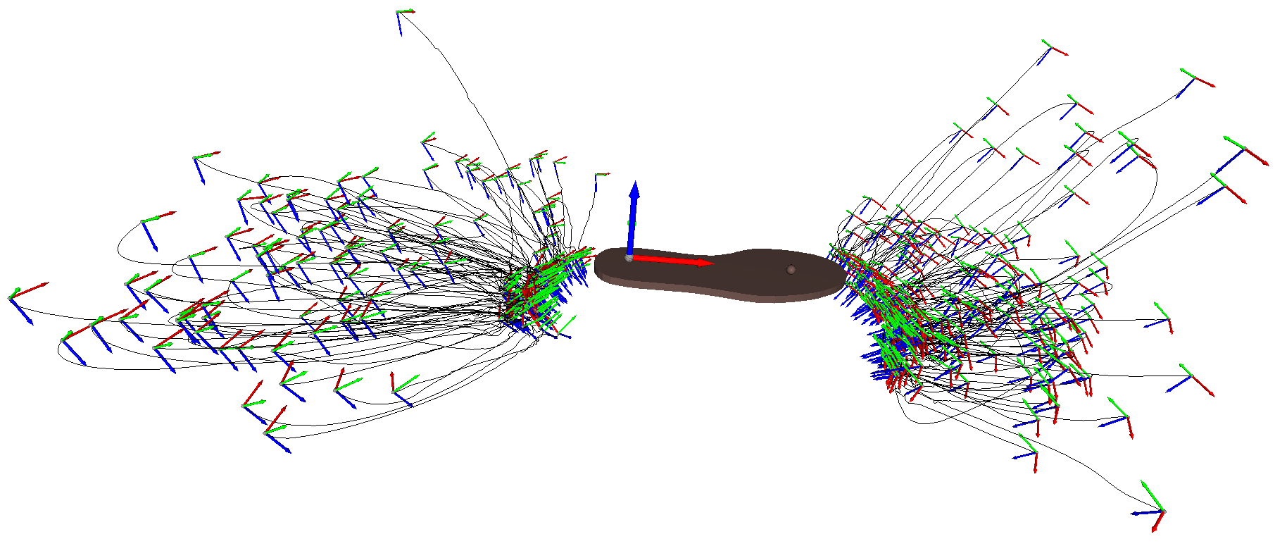
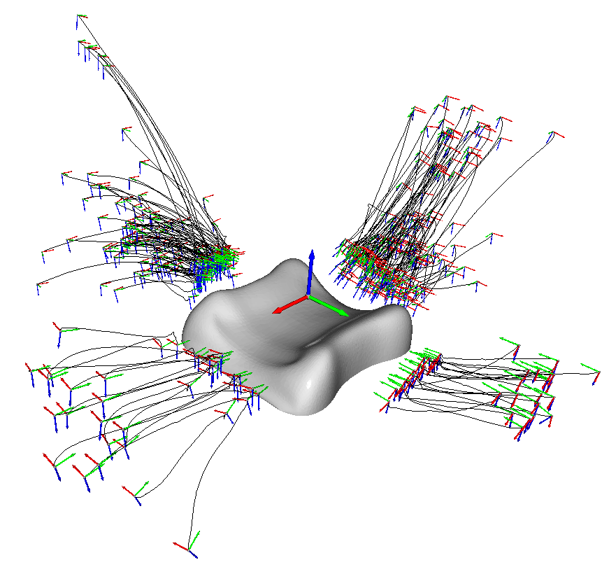
Motion Capture Dataset
End-effector trajectories of grasping motions
Task | Object | Samples
Grasp | Insole | 213
Grasp | Small pillow | 224

Slide 8
Demonstration

Slide 9
Record and Embodiment Mapping

Slide 10
Record and Embodiment Mapping

Slide 11
Evaluation

Slide 12
Evaluation - Simulation
Object | Samples | Hand | Success Rate
Insole | 213 | Mia | 71.4 %
 |  | Shadow | 40.4 %
Small Pillow | 224 | Mia | 92.8 %
 |  | Shadow | 65.2 %
Success rates are high, considering that these are open-loop behaviors

Slide 13
Evaluation – Real System
Two conditions
Results
Coordinated movements are more often successful
Real results align with simulation
Coordinated arm + hand
Sequential arm + hand
Criterion | Success rate | Success (trajectories) #
Lifting successful | 83.8% | 67 (80)
Resisted 2.8 N | 72.5% | 58 (80)
Simulation | 70.0% | 56 (80)

Slide 14
Conclusion
Drawbacks
Different morphologies (human vs. robotic hands)
Open-loop behaviors
Advantages
Natural human motion
Good initial solution (to be refined)
Subject, input modality, and target system can be changed easily

Slide 15
Links
Code
https://github.com/dfki-ric/hand_embodiment
Dataset
https://doi.org/10.5281/zenodo.7130208

Slide 16
Embodiment Mapping

Slide 17
Embodiment Mapping

Slide 18
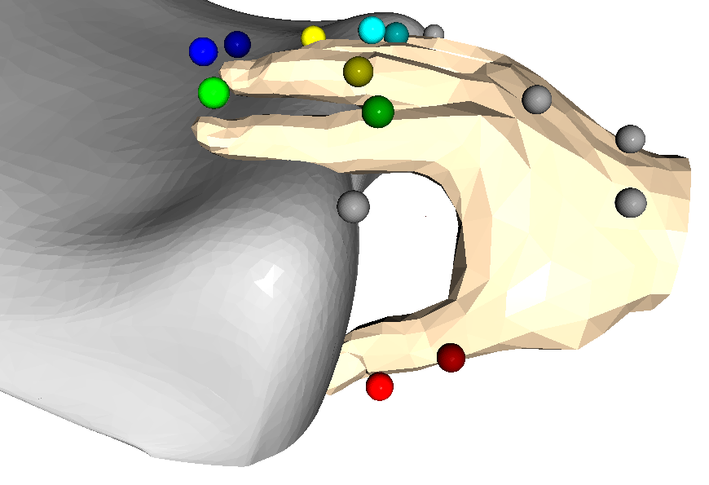
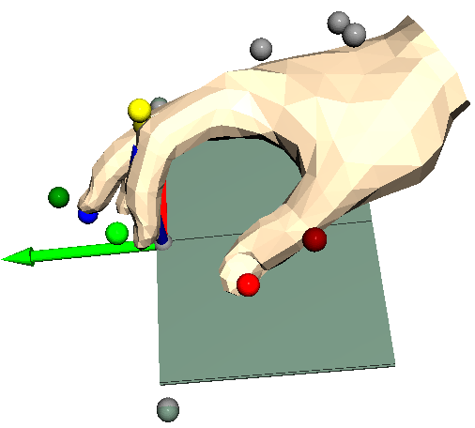
Record Mapping

Slide 19
Record and Embodiment Mapping

Slide 20
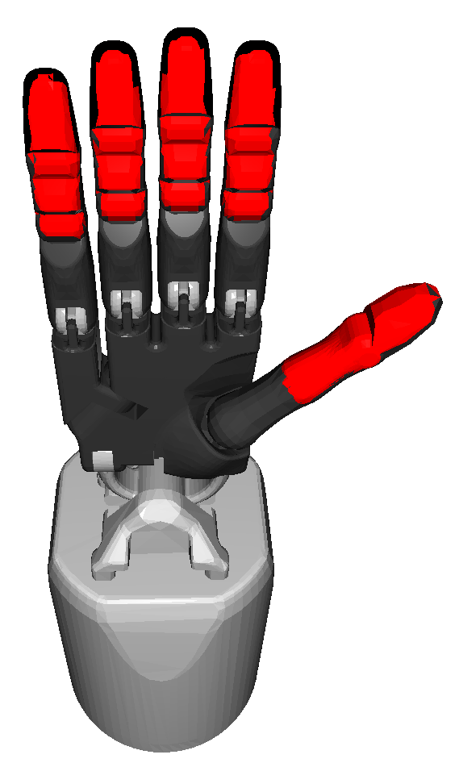
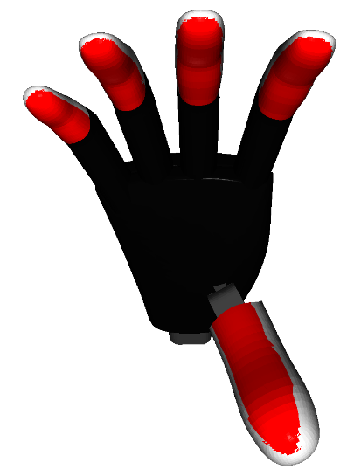
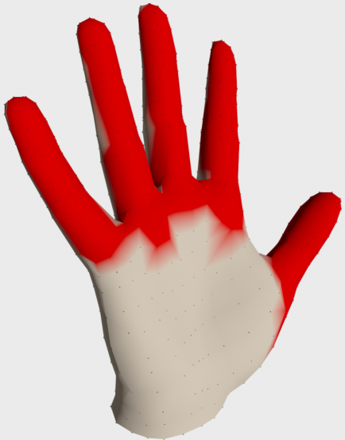
Evaluation – Embodiment
Hand | Thumb | Index | Middle | Ring | Little
Mia | 12.2 | 8.3 | 17.4 | 23.3 | 30.2
Shadow | 5.2 | 6.3 | 5.6 | 5.9 | 9.8
Robotiq 2F-140 | 28.6 | 13.4 | - | - | -
Mean average distance (unit: mm) of contact surfaces. One frame per demonstration (763) was selected. A simple Robotiq gripper with 1 DOF is used as baseline.

Slide 21
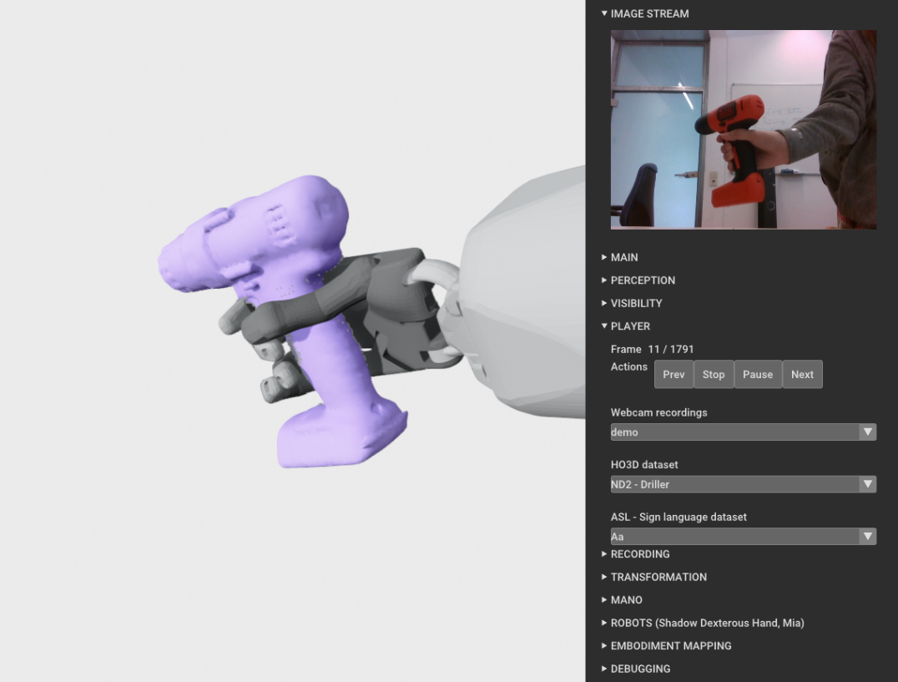
Monocular RGB Images (HO3D)

